Slide 1

Data Engineering: 2022 FIFA World Cup
Solution_Makers
Members:
Dariel Ibanez
Nelson Velasco
Mia Serrano-Salow
Patricia Young

Slide 2
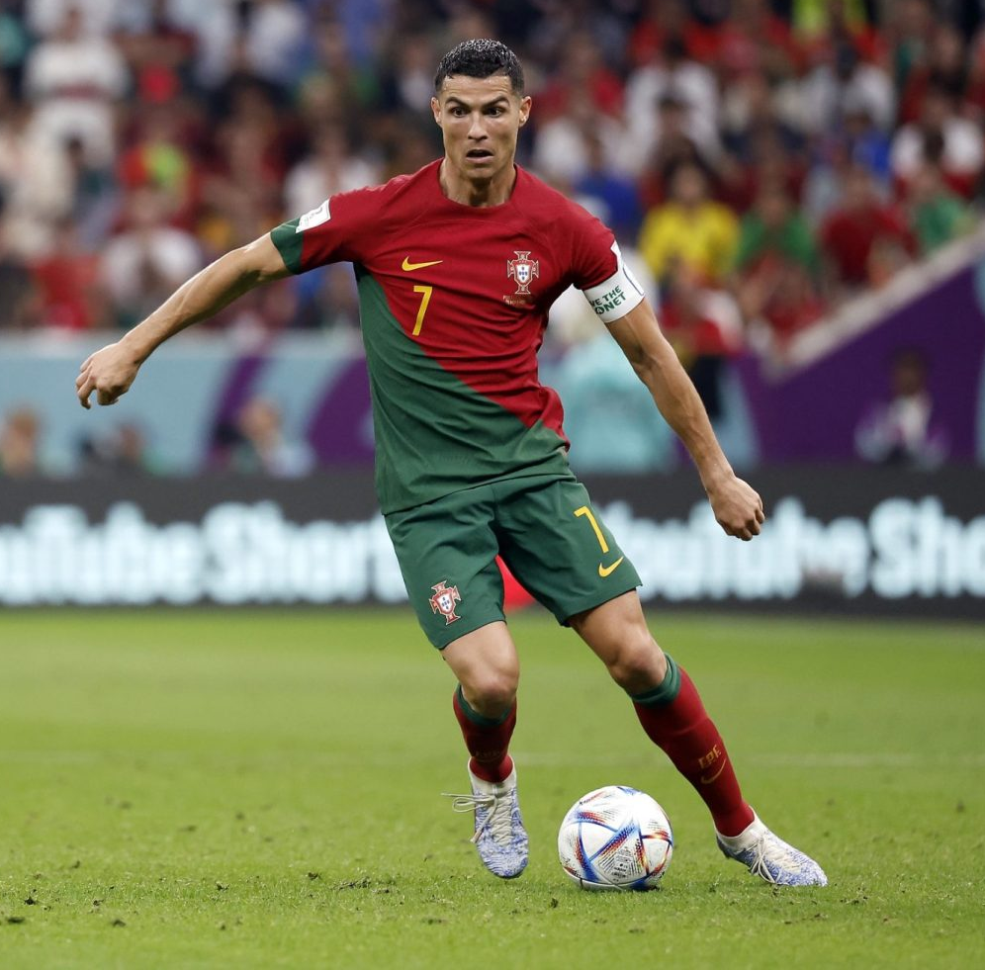
Purpose:
Sports data engineers researching player data from the 2022 FIFA World Cup for team scouts to use
Asked by a client company to process and upload player data from the 2022 FIFA World Cup
Sorted through:
Multiple DataFrames of players offensive and defensive stats throughout the FIFA tournament
Current market value
Overall FIFA Player Score
Why did we choose this topic?

Slide 3

Questions:
What factors should determine what makes the players the “best”?
Who are the players that out performed their market value during the FIFA World Cup?
Who had the most number of goals out of all the players in the FIFA World Cup?
Which players had the most touches per the amount of minutes per game?

Slide 4
Applications Used:
Kaggle
Jupyter Notebook
Pandas and Polars
We exported the dataframe as a csv file and loaded it into pgAdmin as a SQL database
Then exported the data back out of pgAdmin and back into the Jupyter Notebook to ensure things were working properly
QuickDBD to create the ERD
Notes:
Can speak about why we chose the Kaggle datasets.
Why we chose to clean the data in the juypter notebook/python and use pandas/polars.
Why we opted for a SQL database and not a NoSQL database (we had a more structured dataset to work with which worked better with a SQL database, and we wanted to then use tables to manipulate the data to see trends and that would be better suited in a SQL database)

Slide 5
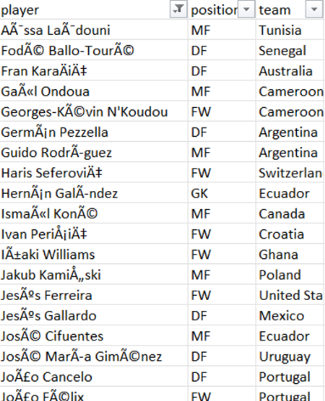
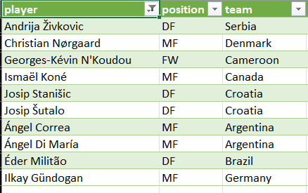
Encoded The Files as ANSI From Unicode UTF8

Slide 6
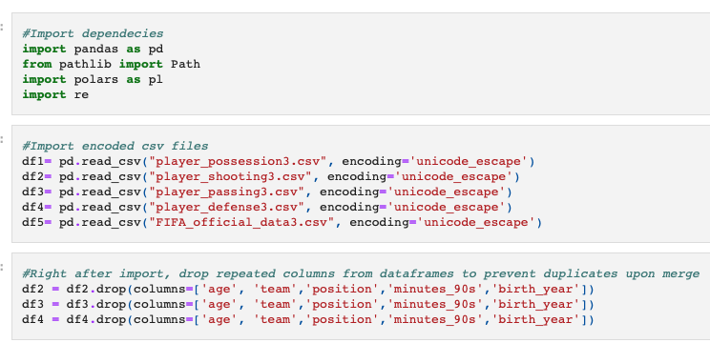
Importing Libraries and Dropping Duplicate Columns

Slide 7
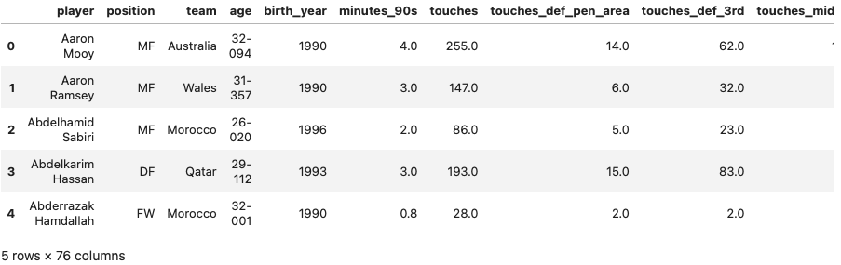
Merged DataFrames

Slide 8
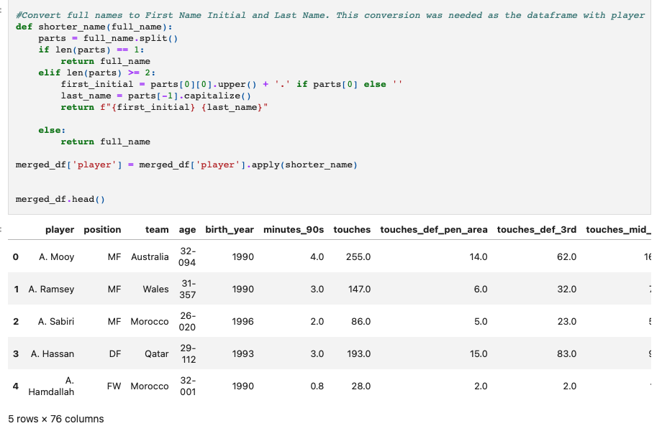
Convert Player First Names to Just Their Initial

Slide 9
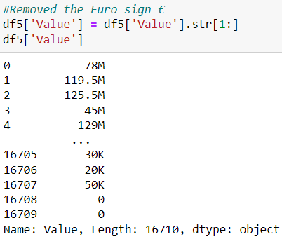
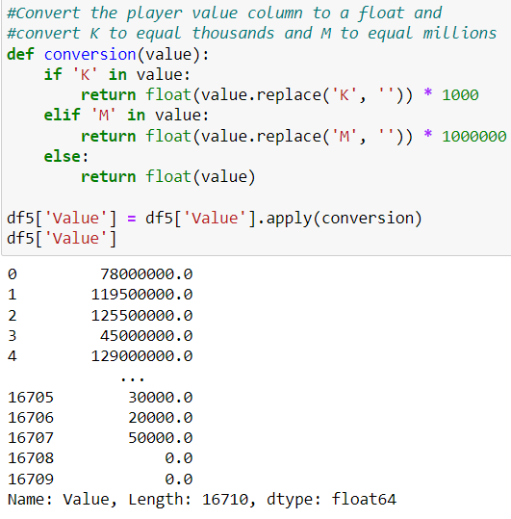
Convert Player Value Column From a String to a Float

Slide 10
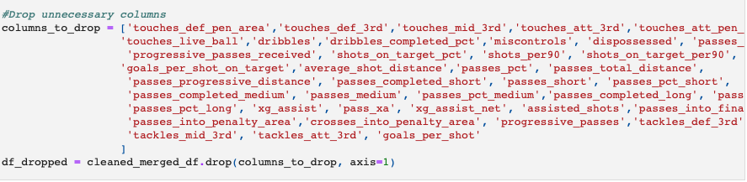
Drop Unnecessary Columns

Slide 11


Slide 12
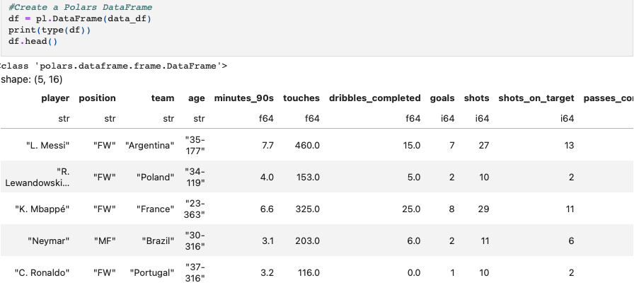
Create a Polars DataFrame

Slide 13
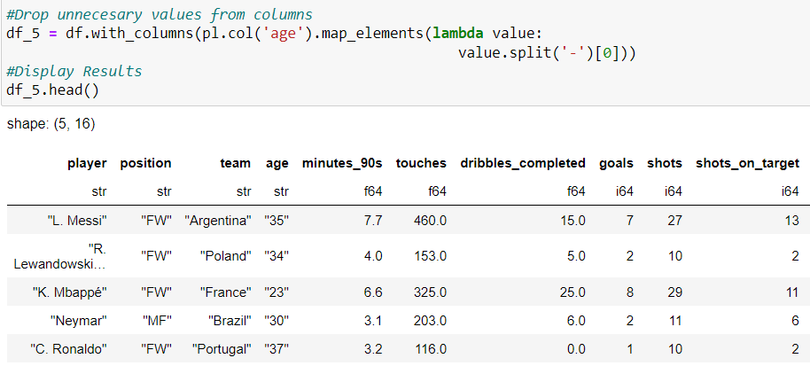
Removing Unnecessary Values

Slide 14
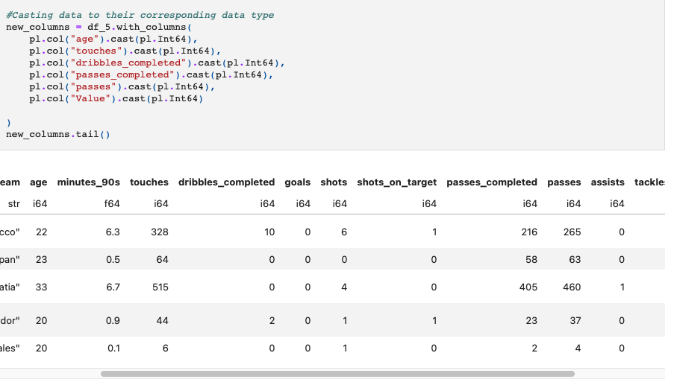
Casting Data

Slide 15
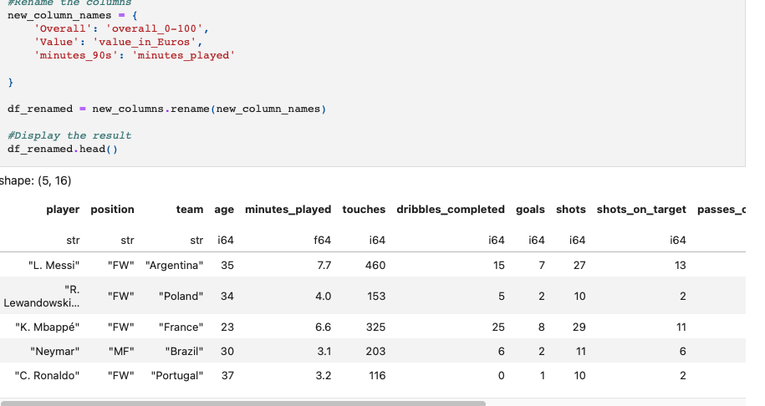
Rename Columns

Slide 16
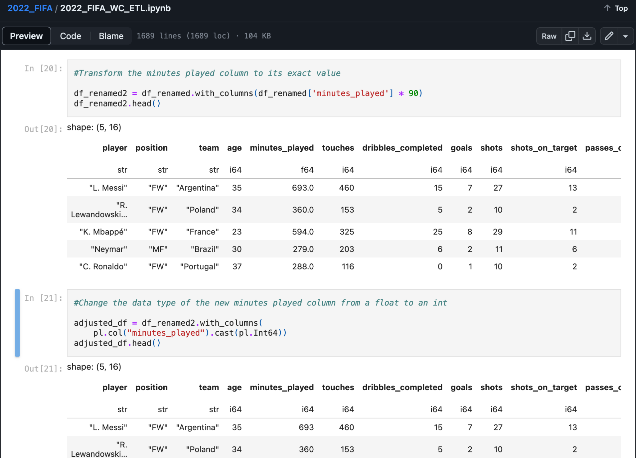
Transformation of Minutes Played Value

Slide 17
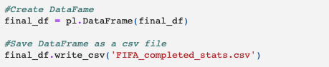

Save Final Data to CSV File

Slide 18
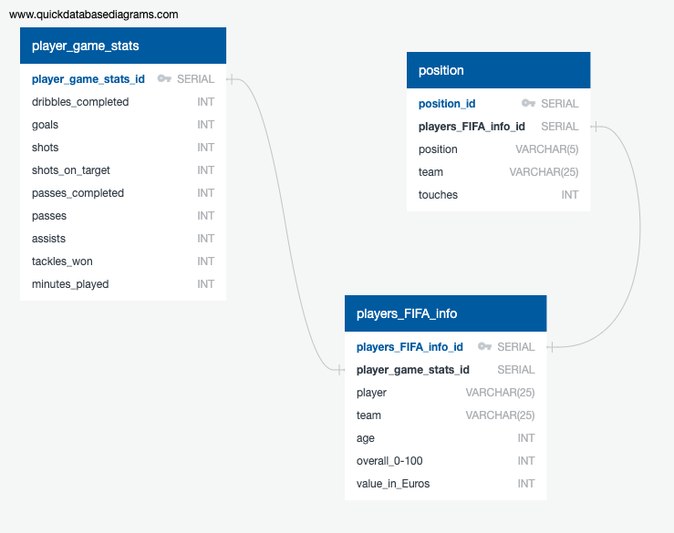
Entity Relationship Diagram (ERD)

Slide 19
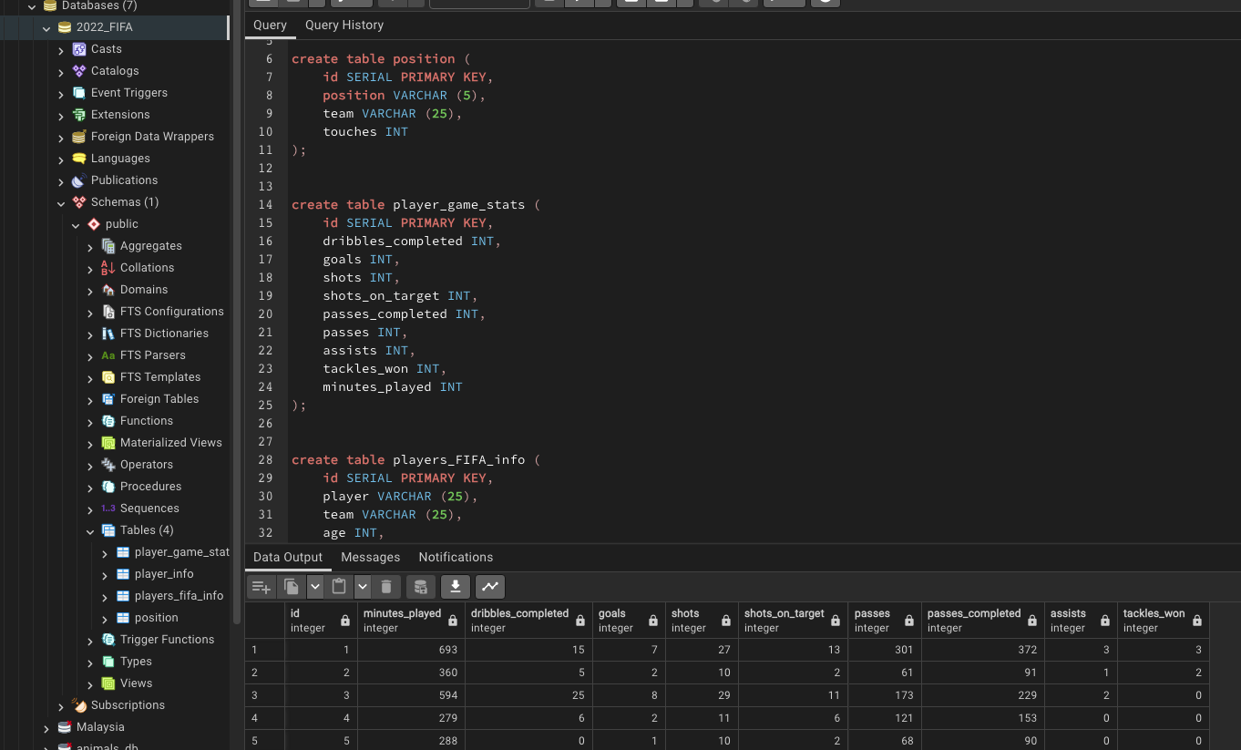
SQL Code for Tables

Slide 20
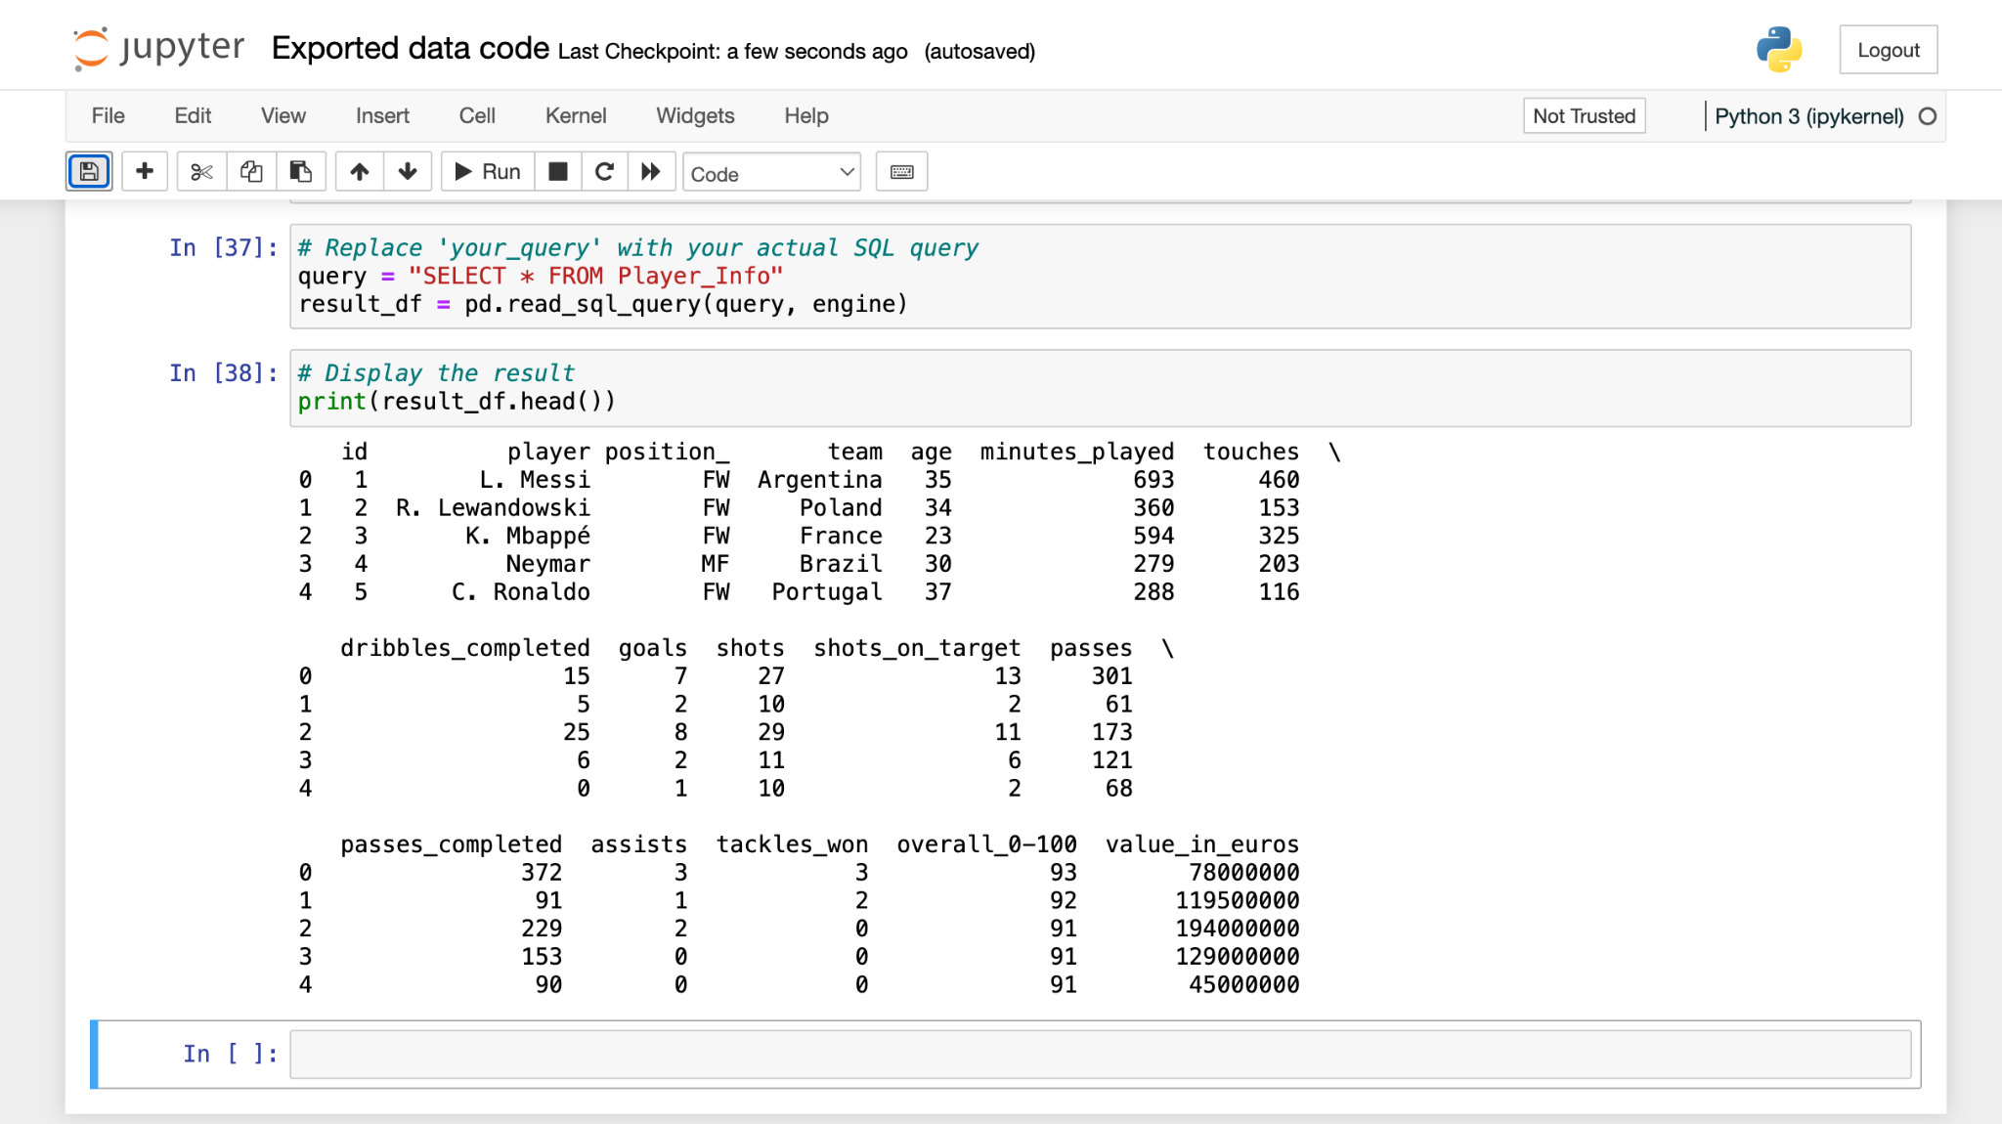
Exported Data

Slide 21
Ethical Considerations
Data Privacy
Consent
Data Usage

Slide 22

Thank you

